Slide 1
Zoroastrianism

Slide 2
Zoroaster likely lived between 1500 and 1000 BC, but some scholarship suggests he may have been a contemporary of Persian emperors Cyrus the Great and Darius I (Credit: Alamy)

Slide 3
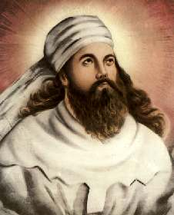
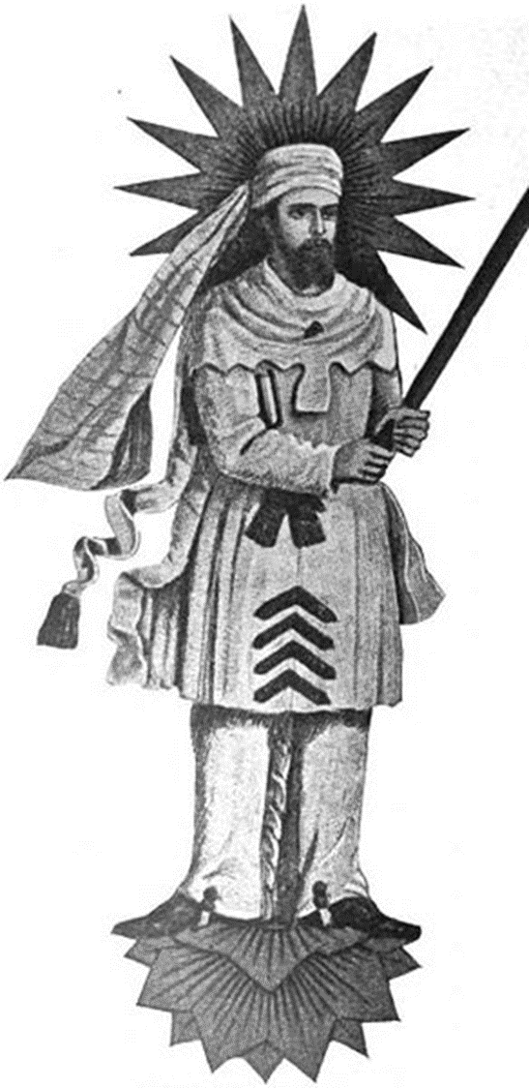
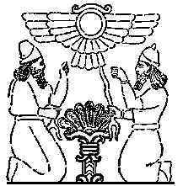
Zoroaster, aka Zarathustra 6c BCE: Good Thoughts, Good Deed, Good Words
“Tree of Life”

Slide 4
Zoroastrianism may have been the first monotheistic religion, and its emphasis on dualities, such as heaven and hell, appear in Judaism, Christianity and Islam (Credit: Alamy)

Slide 5
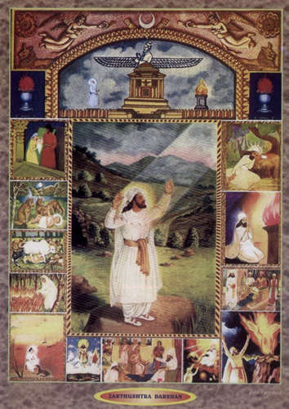
One God - Monotheism
Zoroastrians believe in one God, called Ahura Mazda (meaning 'Wise Lord'). He is compassionate, just, and is the creator of the universe.
Ahura Mazda is:
Omniscient (knows everything)
Omnipotent (all powerful)
Omnipresent (is everywhere)
Impossible for humans to conceive
Unchanging
The Creator of life
The Source of all goodness and happiness

Slide 6
Dualistic Battle of Good vs. Evil
Ahura Mazda
Spenta Mainyu: “Holy Spirit”
Ahriman
Angra Mainyu: “Destructive Spirit”

Slide 7
Zoroastrians worship in fire temples, such as this one in Yazd, Iran – they believe fire and water are the twin agents of purity and necessary for ritual cleansing (Credit: Alamy)

Slide 8
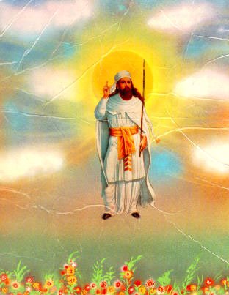
There is no reincarnation at death…that’s it
The moment of death is the moment of truth-Judgment Day- if good, cross bridge into House of happiness - heaven
If bad, fall off bridge into fiery pit - hell
Dead left in “Towers of Silence”
Suspended between heaven and hell bodies consumed by vultures, sacred birds and the soul moves onward

Slide 9
Towers of Silence, such as this one in Chilpyk, Uzbekistan, are where Zoroastrians would leave the bodies of the dead to be consumed by birds (Credit: Alamy)

Slide 11
Raphael’s The School of Athens, finished in 1511, includes a figure, seen in this detail from the larger work, many historians think is Zoroaster, holding a globe (Credit: Alamy)

Slide 12
Freddie Mercury, the legendary lead singer of Queen, drew inspiration from the Zoroastrian faith of his Persian family (Credit: Alamy)

Slide 13
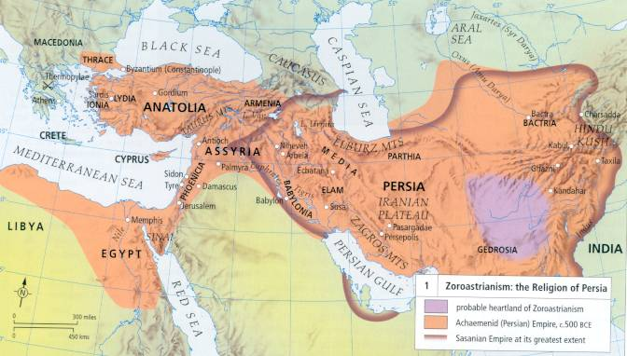
Extent of Zoroastrianism
-Did not spread widely beyond Persia. Alexander and later Islam were disastrous for the faith.
-Small minority in Iran remains, mostly in mountains

