Slide 1
AP WORLD HISTORY PERIOD 2: 600 BCE – 600 CE
Organization and Reorganization of Human Societies

Slide 2
Key Concept 2.1 Development & Codification of Religious & Cultural Traditions
Religion provides:
Community bonds & moral and ethical codes to follow
Reinforces social stratification
Merged with political rulers to justify their reign
Differences lead to conflict
Remember 2 Religions began in Period 1
Judaism & Hinduism

Slide 3
Key Concept 2.1 Development & Codification of Religious & Cultural Traditions
Hinduism
India (spread to SE Asia)
Vedas brought by Aryans (Indo-Europeans)
Codified in Sanskrit 500BCE
No founder, cultural diffusion
Brahman – supreme soul
Karma (actions), Dharma (duties), Reincarnation (rebirth), Moksha (one with universe)
Caste System – rigid social system
Patriarchal
Major continuity in India

Slide 4
Key Concept 2.1 Development & Codification of Religious & Cultural Traditions
Buddhism
India 500 BCE
Founder = Siddhartha Gautama (Buddha)
Developed from Hinduism
4 Noble Truths (suffering and desire) & 8 Fold Path (“right life”)
Nirvana – accessible to everyone in this lifetime
Accepted karma, dharma, and reincarnation, rejected caste system
Appealed to poor, equality of believers, offered monastic life
Universal Religion – seeking converts
Spread through Emperor Asoka of the Mauryan Empire, converted to Buddhism
Spread East to China, Korea and Japan along Silk Roads and Indian Ocean Trade
Mahayana (Buddha as a God) vs. Theravada (original)

Slide 5
Key Concept 2.1 Development & Codification of Religious & Cultural Traditions
Confucianism
China, Warring States Period, 500 BCE
Founder: Confucius
Filial Piety – respect for elders
5 Key Relationships (superior & inferior)
Patriarchal
Civil Service Exam started by Han (education, merit based bureaucracy)
Provided social order and stability to China, embraced by Chinese government; continuity in China

Slide 6
Key Concept 2.1 Development & Codification of Religious & Cultural Traditions
Daoism
China, Warring States Period, 500 BCE
Founder: Laozi
Harmony with Nature
Balance (yin and yang)
Disengage and just be
Profound effect on Chinese culture (medicine, poetry, metallurgy, architecture)

Slide 7
Key Concept 2.1 Development & Codification of Religious & Cultural Traditions
Judaism
Began in Middle East
Founder: Abraham
1st Monotheistic
Covenant/agreement with God
Torah (holy book) codified 500 BCE
Hebrew communities were conquered which led to diaspora (scattered)

Slide 8
Key Concept 2.1 Development & Codification of Religious & Cultural Traditions
Christianity
Founder: Jesus 30 CE
Developed from Judaism
Equality of believers, appeals to poor and women, offered a monastic life
Universal religion, spread through missionaries, trade, Roman Roads
1st persecuted by Romans, become official religion of empire in 380 CE Constantine
Spreads throughout Mediterranean Region

Slide 9
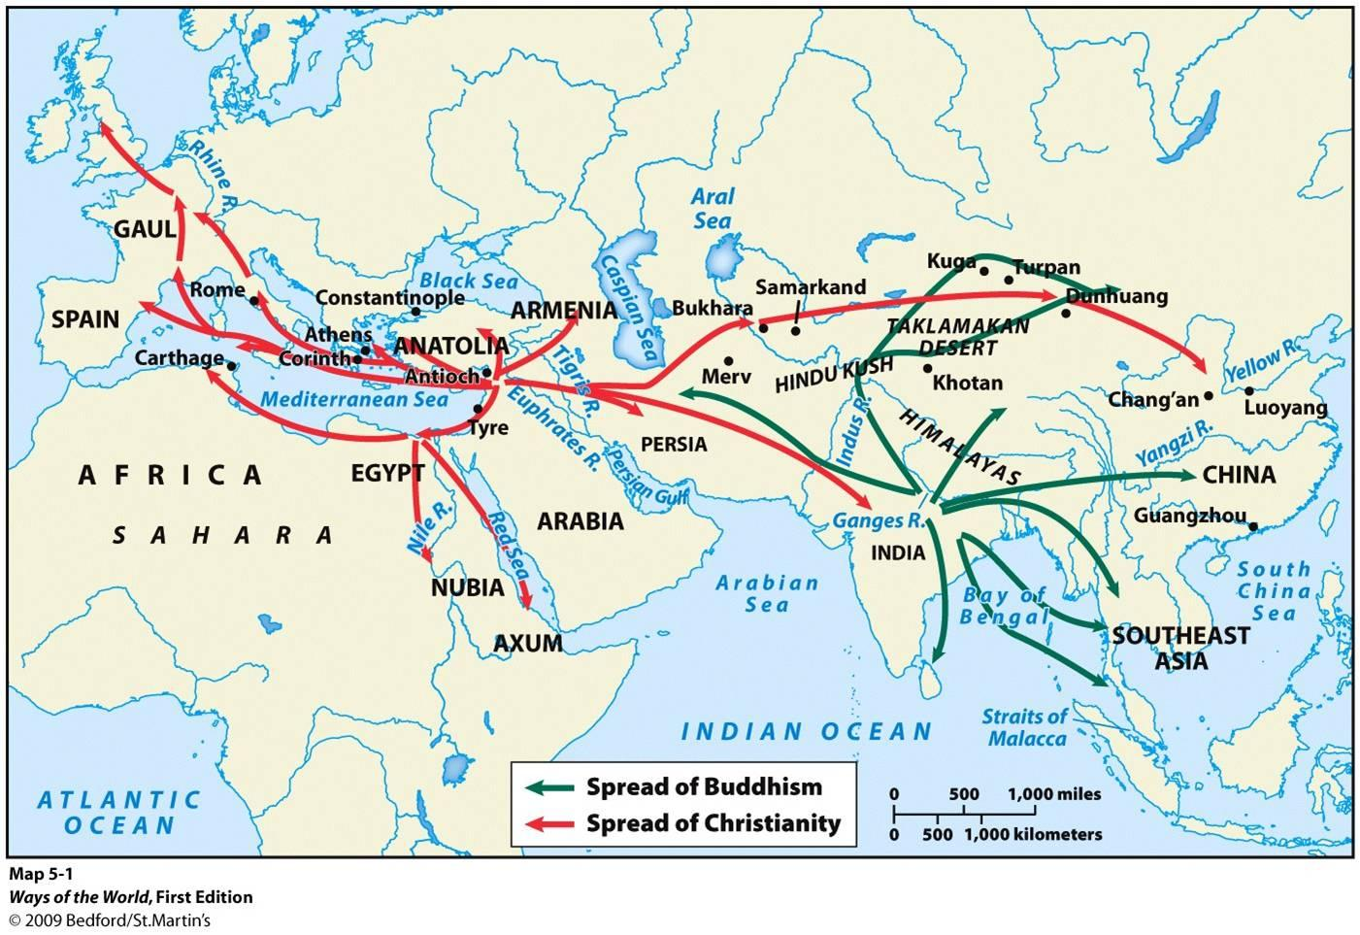
Spread of Universal Religions

Slide 10
Key Concept 2.1 Development & Codification of Religious & Cultural Traditions
Greco-Roman Philosophy
500 BCE
Questioned range of ideals
Science, math, elements, gods, universe, reasoning, logic, Socratic Method, Scientific Method, Socrates, Plato, Aristotle

Slide 11
Key Concept 2.1 Development & Codification of Religious & Cultural Traditions
Axial Age Theory
New religious beliefs develop across the world at around the same time
Confucianism, Buddhism, Daoism, and Greco-Roman Philosophy
Christianity 400 years later
Islam 1000 years later

Slide 12
Key Concept 2.1 Development & Codification of Religious & Cultural Traditions
Animism and polytheism used outside core civilizations, focused on nature, shamanism (spirit guides)
Greco-Buddhism = syncretism, blending of two cultures (Alexander the Great)

Slide 13
Key Concept 2.2 Development of States and Empire
China
Zhou (Mandate of Heaven, longest dynasty, ends in 256 BCE and leads to Warring States Period)
Qin (221-206 BCE)
Short but important
Shi Huangdi 1st Emperor,
Unified China for 1st time
Legalism (Harsh)
Centralized government
Began Great Wall (finished by Ming)
Standardized weights and measurements
Tomb of Terracotta Warriors

Slide 14
Key Concept 2.2 Development of States and Empire
China
Han (206 BCE – 220 CE)
Golden Age – peace, stability, achievements
Centralized government
Confucianism – some social mobility
Civil Service Exam – merit based bureaucracy
Began Silk Roads, linked to Europe
Capital city – Chang’an
Patriarchy
Merchants looked down on
Achievements: coined $, paper, clocks, compass

Slide 15
Key Concept 2.2 Development of States and Empire
India – (usually politically decentralized, empire is NOT the norm)
Mauryan (322 – 185 BCE)
Founder: Chandragupta Maurya united subcontinent
Larger of 2 early empires
Grandson Asoka converted to Buddhism and spread religion; Rock Pillars
Gupta (320 – 600 CE)
Golden Age (Arabic Numerals, concept of zero, base 10)
Hinduism and Sati (patriarchy)

Slide 16
Key Concept 2.2 Development of States and Empire
Mediterranean Empires
Persian Empires (present day Iran)
Achaemenid (550 – 330 BCE)
Cyrus the Great built largest empire in the world
Zoroastrianism; religiously tolerant
Royal Road System (1,600 miles)
Strong military, used satraps (regional leaders) to help rule
Conquered by Alexander the Great
Parthian (247-224 CE)
Center of trade on Silk Road, often fought with Roman Empire
Sassanid (224 – 651 CE)
Last Pre-Islamic Persian Empire
Considered world power with Rome/Byzantines

Slide 17
Key Concept 2.2 Development of States and Empire
Mediterranean Empires
Greece
City-states, not unified, many types of government but had common language and religion
Geography: Mountainous, Importance of the seas and trade
Athens (Democracy, philosophy, Coliseum) vs. Sparta (totalitarian oligarchy, military)
City-states unite to defeat Persia
Peloponnesian Wars (Athens vs. Sparta – 431-404 BCE)
Wars weaken Greece and make way for Phillip II of Macedon (Alexander the Great’s Father)

Slide 18
Key Concept 2.2 Development of States and Empire
Mediterranean Empires
Hellenistic Empire (740 – 146 BCE)
Alexander the Great
Conquered Greece, Egypt, Persia and Northern India
Golden Age (libraries, geometry, cities – Alexandria, Egypt)
Syncretism: Greco-Buddhism in South Asia
Died at age of 33 in 323 BCE
Empire broke up into 3 pieces

Slide 19
Key Concept 2.2 Development of States and Empire
Mediterranean Empires
Roman Empire
Began with Romulus & Remus
Republic (citizens have say in government) (500 BCE – 30 BCE) with Patricians vs. Plebeians and the Senate
Punic Wars vs. Carthage (Hannibal)
Julius Caesar assumed dictatorship 48 BCE
Augustus Caesar and the Pax Romana (Golden Age)
Law (12 Tables), engineering (roads, aqueducts), Silk Road, use of slavery
Christianity becomes official religion 380 CE

Slide 20
Key Concept 2.2 Development of States and Empire
American Empires
Mayan Empire (250 – 900 CE)
City-states in Mesoamerica (central America)
Achievements: calendar, step pyramids, glyphs, astronomy, terrace farming
Teotihuacan
One of the biggest cities in classical era
Traded with Mayan
Human sacrifice
Complex bureaucracy and pyramids
Moche: Andean (100 – 800 CE)
Gold, architecture, irrigation, terrace farming, human sacrifice

Slide 21
Key Concept 2.2 Development of States and Empire
Common Attributes of Classical Empires
Large empires required advanced bureaucracies
1st major trade centers developed (cities) glorified empires
Food production was key
Widespread slavery
Patriarchy and social hierarchies based on occupation
Comparisons of Empires
Maya & Gupta (concept of zero)
Rome & Han (Silk Roads)
Greeks & Romans (dependence on slavery)
Mayans & Greeks (city-states)

Slide 22
Key Concept 2.2 Development of States and Empire
Common Attributes of Classical Empires
Large empires required advanced bureaucracies
1st major trade centers developed (cities) glorified empires
Food production was key
Widespread slavery
Patriarchy and social hierarchies based on occupation
Comparisons of Empires
Maya & Gupta (concept of zero)
Rome & Hand (Silk Roads)
Greeks & Romans (dependence on slavery)
Mayans & Greeks (city-states)

Slide 23
Key Concept 2.2 Development of States and Empire
Comparing Roman and Han Empire
Rome |  | Han
Heavy reliance on slavery | Social Structure | Heavy reliance on peasants (respected)
Centralized | Political | Centralized, merit based bureaucracy based on civil service exams
Trade along Silk Road and Mediterranean Sea | Economic | Trade along Silk Roads and Indian Ocean Trade
Absorbed foreign religion in later years (Christianity) Achievements in law & engineering (roads) | Culture | Absorbed foreign religion in later years (Buddhism) Achievements include roads & civil service exam

Slide 24
Key Concept 2.2 Development of States and Empire
Collapse of Classical Empires
Over-extension of borders
Internal disruptions
Breakdown of imperial authority; political corruption
Failing economies
Peasant revolts against landlords (Han - Yellow Turban Revolt); resistance to high taxes
External Invasions
Rival empires and nomadic
476 CE Roman Empire (Huns, Goths, Vandals)
220 CE Han (Xiongnu)
China comes back after collapse; Rome does not
Causes of Decline in Americas is unknown

Slide 25
Key Concept 2.3 Emergence of Transregional Networks of Communication and Exchange
Silk Roads
Land based trade routes
Chinese monopoly on silk (desirable and expensive)
Goods Traded
From E. Asia to W: Silk, horses, spices, furs, rice,, porcelain
From S Asia to E & W: cotton, spices, sandal wood, rice
From C. Asia to E, W & S: dates, almonds, fruit, camels, horses
From points west (Med. Sea): glass, gold, olive oil, perfumes
Technology: qanat system (irrigation, transports water from below ground to surface in arid regions – C. Asia to SW Asia)
Buddhism spreads from India to China to Korea to Japan
Disease spreads (Black Death/Plague)

Slide 26
Key Concept 2.3 Emergence of Transregional Networks of Communication and Exchange
Indian Ocean Trade
Largest sea routes until 1400s
Connected SE Asia, China, Africa, Middle East and South Asia
Depended on monsoon winds
New technology
Dhows – small but seaworthy trading ships used by Arab merchants
Lateen sail - triangular

Slide 27
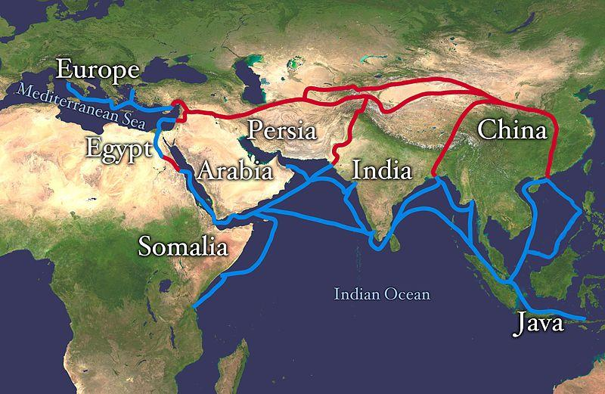
Indian Ocean Trade and Silk Roads

Slide 28
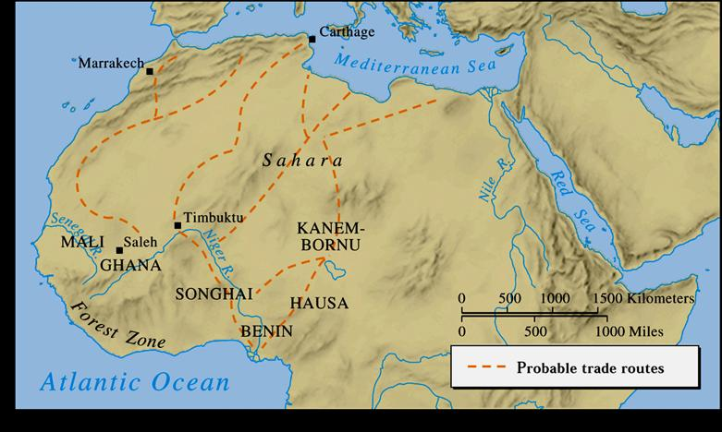
Key Concept 2.3 Emergence of Transregional Networks of Communication and Exchange
Trans-Saharan Trade Routes
North Africa to Mediterranean coastal cities
Goods Traded
From Africa: Gold , salt, ivory, animal hides and slaves
From Med.: dates, cotton, dyes, cloth, leather, glass
Introduction of camel 1st Century CE, saddle 300 CE

Slide 29
Key Concept 2.3 Emergence of Transregional Networks of Communication and Exchange
Other Notable Trade Routes
Mediterranean Sea (Greeks, Phoenicians, Burburs)
Sub-Saharan Trade Routes (Bantus connect sub-Saharan Africa to E. Africa)
Black Sea
Who’s Missing? The Americas
Why? Smaller scale trade, fewer large domestic animals, no wheel, geography N-S made trade difficult
Mayan and Teotihuacan in Mesoamerica and within Moche

Slide 30
Period 2 Review Questions
1. Monasticism is a characteristic of which of the following religions?
Judaism
Hinduism
Confucianism
Buddhism

Slide 31
Period 2 Review Questions
2. In which of these societies were merchants and traders placed in a lower social class than farmers and artisans
Han China
India
Japan
Rome

Slide 32
Period 2 Review Questions
3. After the Peloponnesian War, the Macedonians took control of Greece and spread Greek culture throughout much of the known world under the leadership of
Julius Caesar
Hannibal
Alexander the Great
Pericles

Slide 33
Period 2 Review Questions
4. In China, Confucianism emphasized the idea that
Equality should exist among all members of society
Salvation could be attained by prayer, meditation and good deeds
Harmony could be achieved by the proper behavior of each member of the family or society
People are fundamentally evil and need to be led by a strong central government

Slide 34
Period 2 Review Questions
5. In comparing the Han Dynasty with the Roman Empire, which of the following statements is NOT accurate?
Both the Han Dynasty’s and Roman Empire’s economies suffered as a result of military spending
While Rome was successful at spreading its culture across a wide area, the Han were unable to diffuse their culture to neighboring lands
While both societies were run by centralized governments, Rome gave significant autonomy to local officials
While the Chinese were able to re-establish their imperial empire, Rome was never restored to its former status.

Slide 35
Period 2 Essay Question
Compare the political and social impacts of two of the following belief systems.
Hinduism, Confucianism, Christianity

Slide 36
Period 2 Essay Question
Compare the reasons for and the outcomes of the fall of TWO of the following classical civilizations
The Roman Empire
Han China
Gupta India

Slide 37
Period 2 Essay Question
Compare the political and cultural characteristics of two classical empires.

Slide 38
Period 2 Essay Question
Analyze the cultural and political changes and continuities in ONE of these civilizations during the early classical era from 1,000 to 1BCE
Rome
China

